Slide 1
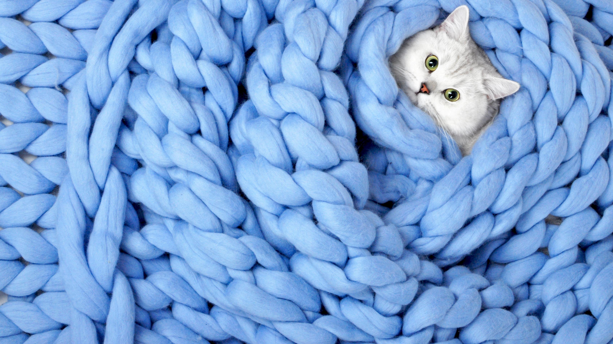
Maths for Yarn-ies
Hannah Hodge Waller

Slide 2
Introduction
Interchangeable for Knitting and Crochet
Non Exhaustive
Additional Topics to research at the end
Things that may be useful
Pen/Paper
Excel Spreadsheet
Calculator

Slide 3

Pattern
Notes:
Tin Can Knits Flax Worsted
https://tincanknits.com/pattern/flax-worsted?g=12
Why?
Free pattern
Well Written
In Worsted Weight yarn – not common in the UK

Slide 4
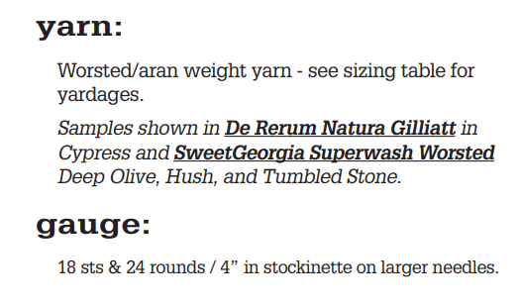
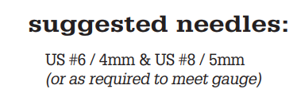

Slide 5
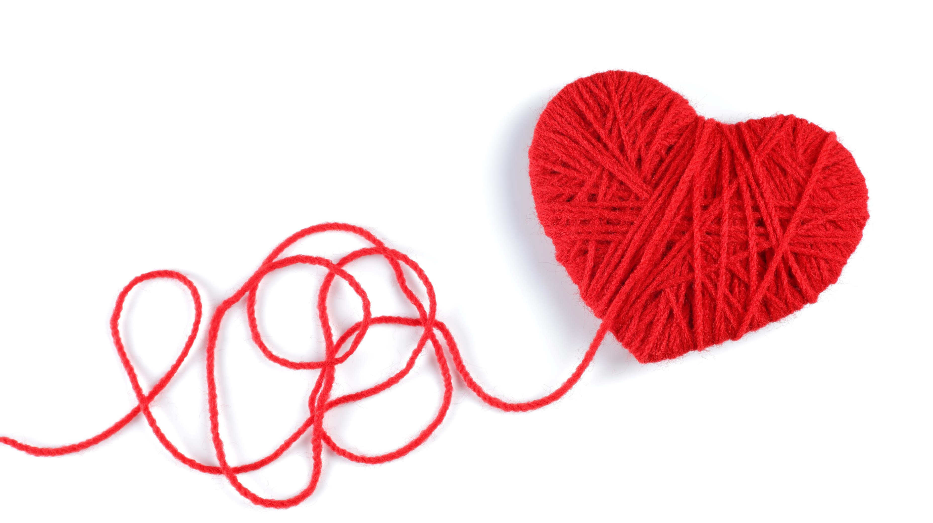
Buying Yarn

Slide 6
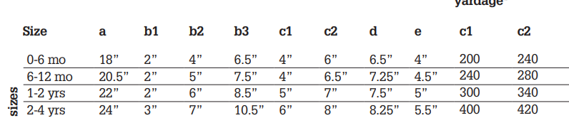

Slide 7
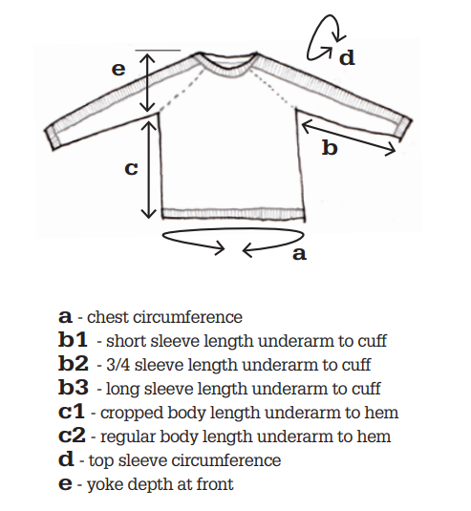

Slide 9
280 yards is ~257 meters

Slide 10
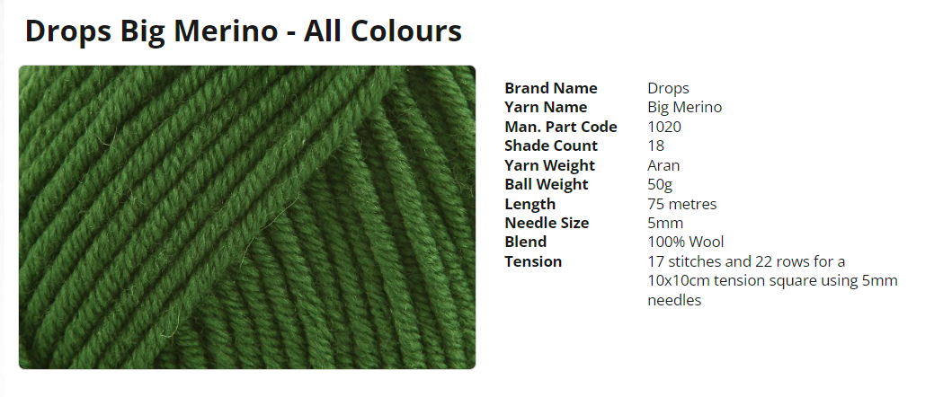
Pattern Gauge

Slide 11
How much?
280 yards is ~257 meters
Meters Needed / Ball Length (M) = Number of Balls
257 / 75 = 3.42 balls
Pattern Gauge

Slide 12
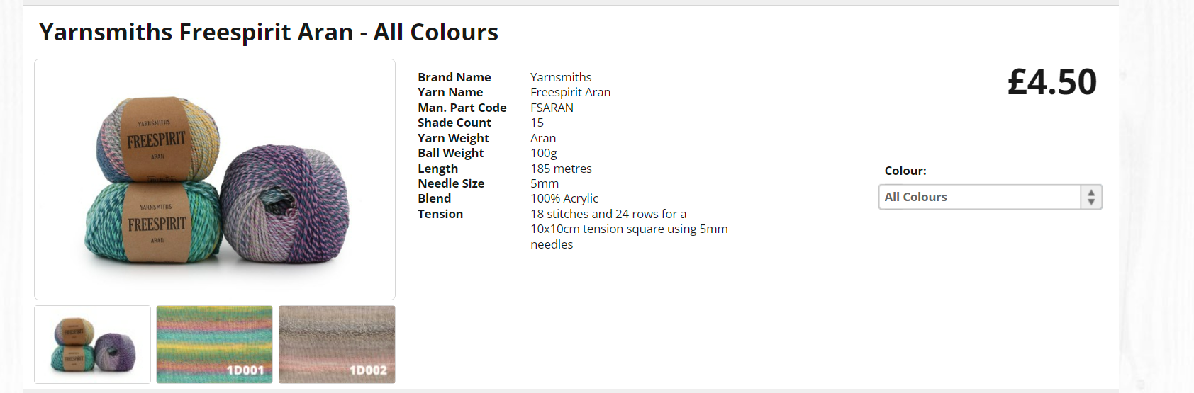
Pattern Gauge

Slide 13
How much?
280 yards is ~257 meters
Meters needed / Ball Length (M) = Number of Balls
257 / 185 = 1.39 balls
Pattern Gauge

Slide 14
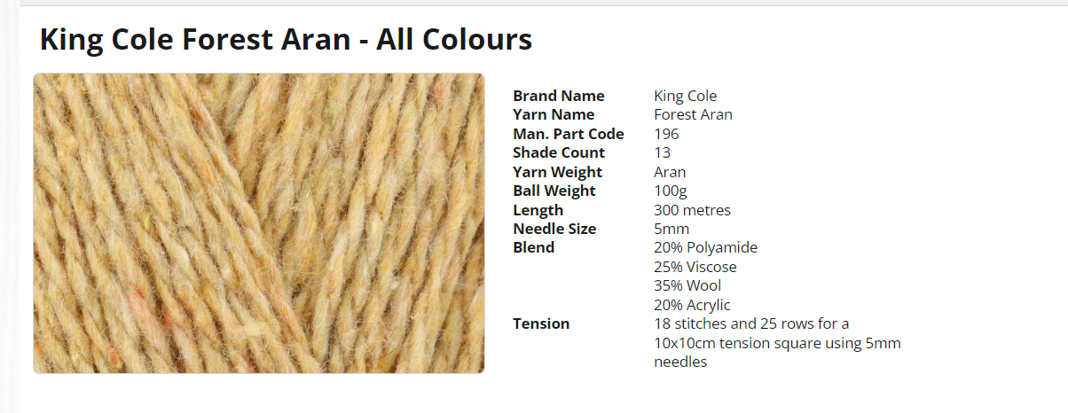
Pattern Gauge
Notes:
Same physical weight of yarn -100g but many more meters. This is due to material and the way it’s spun. Notice open airy texture. Would expect a lighter yarn than the previous.

Slide 15
How much?
280 yards is ~257 meters
Meters Needed / Ball Length (M) = Number of Balls
257 / 300 = 0.85 balls
Pattern Gauge
Notes:
Same physical weight of yarn -100g but many more meters. This is due to material and the way it’s spun. Notice open airy texture. Would expect a lighter yarn than the previous.

Slide 16
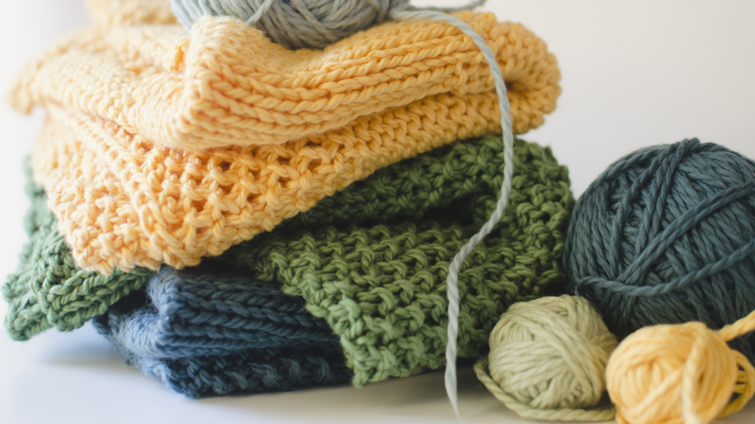
Swatching

Slide 17
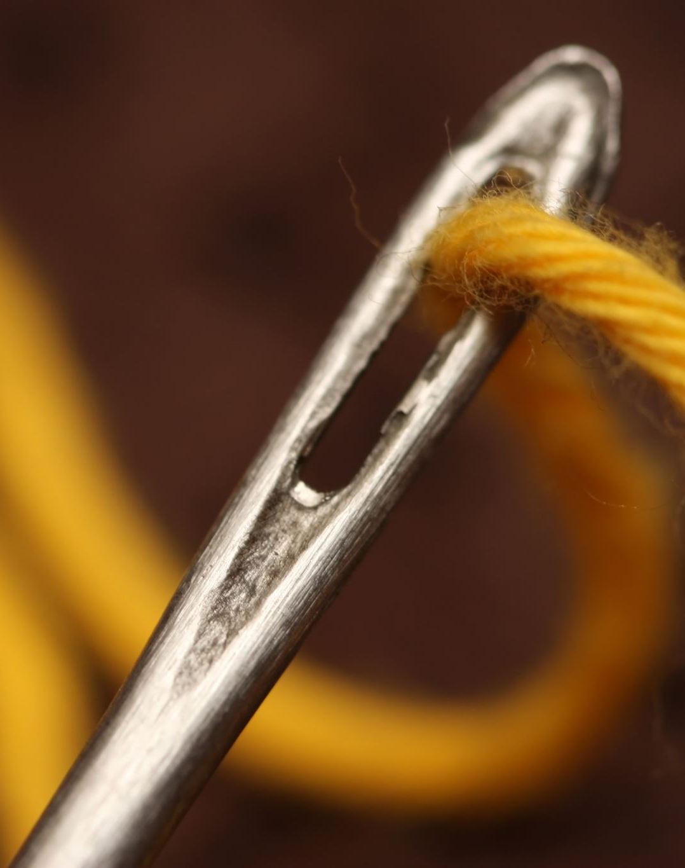
Swatch Golden Rules
You should knit (or crochet) a tension square or swatch.
Use the yarn you intend to use
Use the needles or hooks you intend to use
Follow pattern instructions (work in correct stitch pattern, in the round etc)
Work larger swatch than pattern says – 15cm x 15cm (6x6 inches)
Finish like final garment
Measure swatch from middle

Slide 18
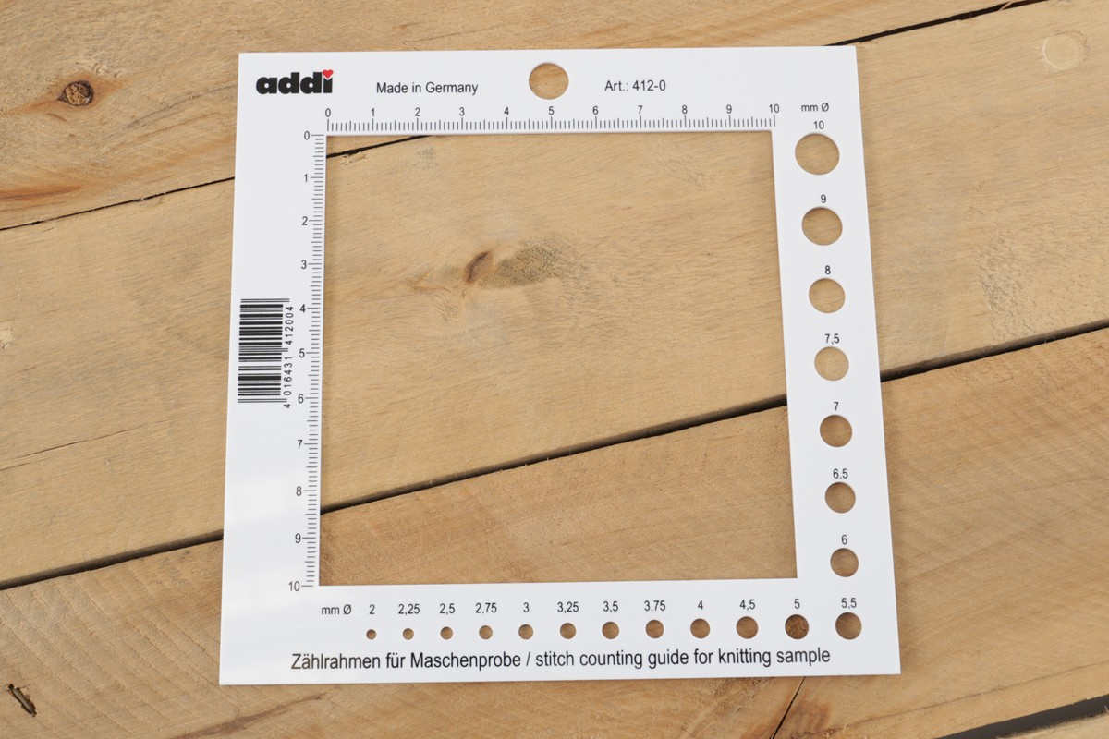
Notes:
https://www.woolwarehouse.co.uk/addi-counting-frame-stitch-counting-guide-for-knitting-sample

Slide 19
My tension is off!
I have too few stitches - e.g. 16 stitches
Stitches are too big, reduce needle size and try again

Slide 20
My tension is off!
I have too few stitches - e.g. 16 stitches
Stitches are too big, reduce needle size and try again
I have too many stitches – e.g 20 stitches
- Stitches are too small, increase needle size and try again.

Slide 21
My tension is off!
I have too few stitches - e.g. 16 stitches
Stitches are too big, reduce needle size and try again
I have too many stitches – e.g 20 stitches
Stitches are too small, increase needle size and try again.
But what if I like the fabric I’ve created?

Slide 22
My tension is off!
I have too few stitches - e.g. 16 stitches
Stitches are too big, reduce needle size and try again
I have too many stitches – e.g 20 stitches
Stitches are too small, increase needle size and try again.
But what if I like the fabric I’ve created?
MATHS!

Slide 23
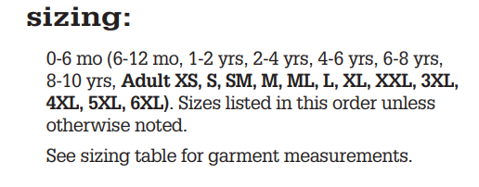

Slide 25
Read your pattern!
This pattern starts top down.
I know no additional shaping is done after the divide for the sleeves.
Measurement A is from this point.
[80 (92, 100 ….) body sts on the needles, sleeve sts are now on hold]
A is 20.5 inches, 92 stitches are 20.5 inches.

Slide 26
Sometimes easier to work backwards as we know all of the variables.
Easier to work with stitches per inch rather than over 4 inches.
18st per 4 inches = 4.5 stitches per inch (SPI)

Slide 27
Sometimes easier to work backwards as we know all of the variables.
Easier to work with stitches per inch rather than over 4 inches.
18st per 4 inches = 4.5 stitches per inch (SPI)
SPI x Finished Size = Stitch Count
4.5 SPI x 20.5 inches = ~92 stitches
When dealing with fractional stitches it’s sometimes partially out.

Slide 28
Our smaller tension = 16 stitches per 4 inches (4 SPI)

Slide 29
Our smaller tension = 16 stitches per 4 inches (4 SPI)
SPI x Finished Size = Stitch Count
4 SPI x ? inches = 92 stitches

Slide 30
Our smaller tension = 16 stitches per 4 inches (4 SPI)
SPI x Finished Size = Stitch Count
4 SPI x ? inches = 92 stitches
Flip the equation
Stitch Count / SPI = Finished Size
92 / 4 = 23 inches
If worked according to pattern it would be 2.5 inches too large

Slide 31
Our smaller tension = 16 stitches per 4 inches (4 SPI)
What if I use the numbers from the 0-6 month size instead?

Slide 32
Our smaller tension = 16 stitches per 4 inches (4 SPI)
What if I use the numbers from the 0-6 month size instead?
Measurement A is from this point.
[80 (92, 100 ….) body sts on the needles, sleeve sts are now on hold]

Slide 33
Our smaller tension = 16 stitches per 4 inches (4 SPI)
What if I use the numbers from the 0-6 month size instead?
Measurement A is from this point.
[80 (92, 100 ….) body sts on the needles, sleeve sts are now on hold]
Flip the equation
Stitch Count / SPI = Finished Size
80 / 4 = 20 inches

Slide 34
Our smaller tension = 16 stitches per 4 inches (4 SPI)
What if I cast on the 0-6 month size?
Measurement A is from this point.
[80 (92, 100 ….) body sts on the needles, sleeve sts are now on hold]
Flip the equation
Stitch Count / SPI = Finished Size
80 / 4 = 20 inches
Much closer!

Slide 35
Maths for Custom Patterns
Head circumference – 60cm

Slide 36
Maths for Custom Patterns
Head circumference – 60cm
Tension Square – 40 stitches 80 rows for 10cm

Slide 37
Maths for Custom Patterns
Head circumference – 60cm
Tension Square – 40 stitches 80 rows for 10cm
Finished Size * Stitches per cm = Cast on
60 * 4 = 240 stitches cast on

Slide 38
Maths for Custom Patterns
Caveats:
Most patterns have “ease”
Positive Ease is where the finished measurements are larger than the body
Negative Ease is where the finished measurements are smaller than the body
Zero Ease is where the measurements are the same size

Slide 39
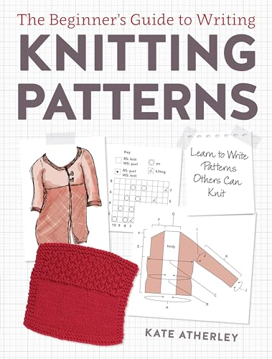
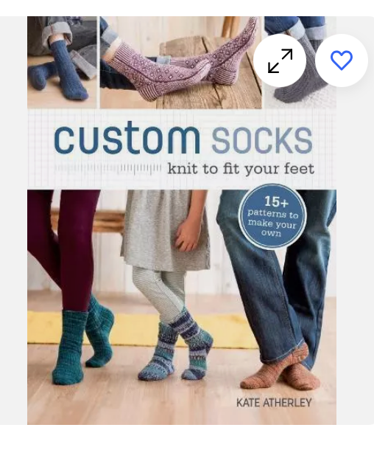
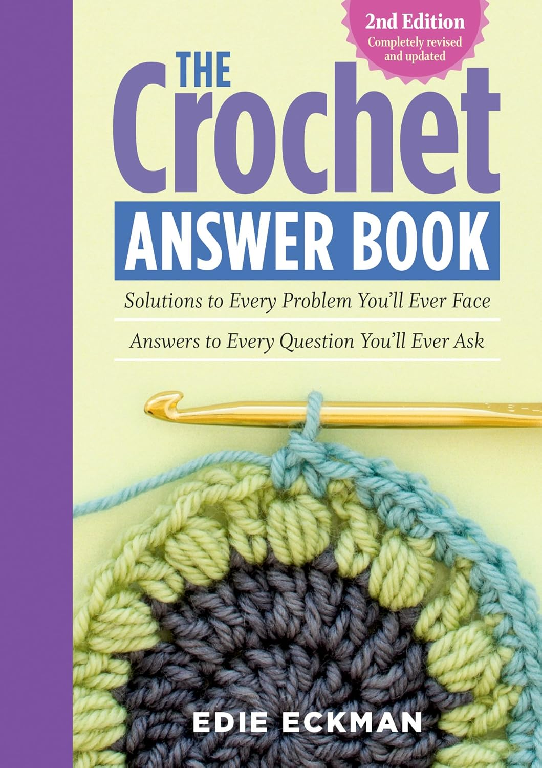
Resources

Slide 40
Resources
Knitting Increase/ Decrease Calculator - https://www.worldknits.com/knitting-calculators
Crochet Increase/ Decrease Calculator https://www.poppyshop.ca/crochetcalculator
Ysolda Teauge – Choosing a Pattern Size https://ysolda.com/blogs/journal/choosing-a-size
TechKnitter – Technical Everything https://techknitter.blogspot.com/2010/04/revised-unified-index-for.html
Edie Echman (Knitting and Crochet) https://www.edieeckman.com/knit-crochet-design-resources/

Slide 41
Resources
Yarn Substitution - How to substitute yarn (yarnsub.com)
Yarn Structure - Yarn Structure Matters to Your Projects - Jill Wolcott Knits
Grist - grist :: it is kind of really important. – Wool n' Spinning (welfordpurls.com)
Substituting Handspan for Commercial Yarn - Spinning to Knit: Creating Your Own Yarn Projects (threadcollective.com.au)
Swatching in the round - How to swatch in the round: the easy way – Ysolda
Ribbing in Hand Knitting - TECHknitting: Ribbing in hand-knitting: its structure + links to "after-knitting" tricks for improvement

Slide 42
Resources
Tighter Ribbing - How to achieve neat, even ribbing in knitting – Suzie Sparkles Knitting (wordpress.com)
Norwegian Purl (Can help with ribbing issues) Knitting Help - Norwegian Purling – YouTube
Tips for stranded colourwork and tension:
- How to Get Your Yarn Tension Just Right for Stranded Colorwork - Sheep Among Wolves
- Ladderback Jacquard Tutorial – Ysolda (Avoid long floats)
- Wovember Words: tips for blocking stranded colourwork YOKES | Wovember (wordpress.com)
Knits that Work for Your Body - Bust adjusted knitting patterns – The Woolly Badger (Thanks Amy!)

Slide 43
Resources
Sock Knitting –
How to knit socks for beginners - easy step by step tutorial [+video] (nimble-needles.com)
Basic 4ply Socks pattern and tutorial - easy beginner sock knitting! – Winwick Mum
Beginner sock knitting: Sockalong - tension squares, casting on and Sock Stitch Calculation – Winwick Mum
Knitty – Largest Online Knitting Magazine (Big Feature technique section and lots of patterns) Knitty.com - Deep Fall 2024

Slide 44
Resources - Books
Libraries!
As well as physical books your library probably has lots of e-books and digital magazines as well.
Newport Library E-books (and Audiobooks to listen to while you craft) through BorrowBox App some craft pattern books online.
Newport Library Magazines though Libby App – including The Knitter
Digital library services | Newport City Council

Slide 45
Resources - Books
The Handknitter's Yarn Guide: A Visual Reference to Yarn Weights and Fibres: Amazon.co.uk: Gabriel, Nikki: 9781844487509: Books
The Fleece & Fiber Sourcebook: More Than 200 Fibers, from Animal to Spun Yarn eBook : Ekarius, Carol, Robson, Deborah: Amazon.co.uk: Kindle Store
Custom Socks: Knit to Fit Your Feet: Amazon.co.uk: Atherley, Kate: 9781620337752: Books
Custom Shawls for the Curious and Creative Knitter: Amazon.co.uk: Atherley, Kate, McBrien Evans, Kim: 9781419743979: Books
Writing Knitting Patterns: Learn to Write Patterns Others Can Knit: Amazon.co.uk: Atherley, Kate: 9781632504340: Books
Exploring Colour in Knitting: Techniques, swatches and projects to expand your knit horizons: Amazon.co.uk: Hazell, Sarah, King, Emma: 9781843405931: Books

Slide 46
Resources - Books
The Crochet Answer Book, 2nd Edition: Solutions to Every Problem You’ll Ever Face; Answers to Every Question You’ll Ever Ask: Amazon.co.uk: Eckman, Edie: 9781612124063: Books
The Knitter's Handy Book of Top-Down Sweaters: Basic Designs in Multiple Sizes and Gauges eBook : Budd, Ann : Amazon.co.uk: Books
Knitters Handy Book Of Patterns: Basic Designs in Multiple Sizes and Gauges: Amazon.co.uk: Budd, Ann: 9781931499040: Books
Knit Fix: Problem Solving for Knitters eBook : Kartus, Lisa: Amazon.co.uk: Books
The Principles of Knitting: Methods and Techniques of Hand Knitting: Amazon.co.uk: Hiatt, June Hemmons: 9781416535171: Books
Finishing School (Master Class for Knitters): A Master Class for Knitters: Amazon.co.uk: Deborah Newton: 9781936096190: Books

Slide 47
Yarn Shops
Wool Warehouse - Home - Wool Warehouse - Buy Yarn, Wool, Needles & Other Knitting Supplies Online!
LoveCrafts - LoveCrafts | Knitting, crochet, craft supplies & inspiration
HobbyCraft / The Range / B&M Bargains / Poundland
UK Hand Knittings list of “Local Yarn Shops” (Many do sell online!) - Finding A Yarn Shop (ukhandknitting.com)
Ammonite Yarns – Pontyclun - Home | Ammonite Yarns

